Slide 1
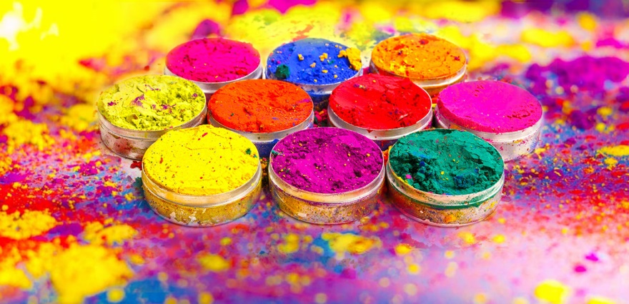
Holi होली

Slide 2
Holi
What is Holi?

Slide 3
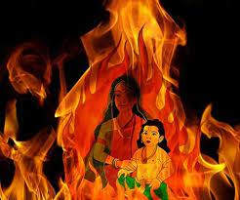
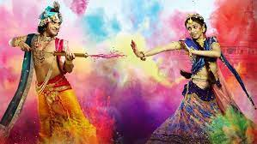
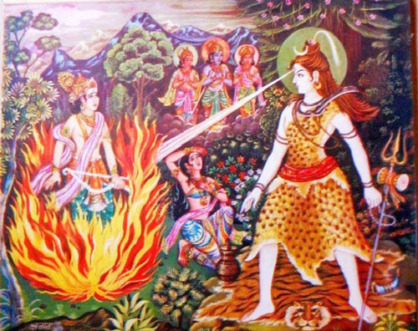
Common Stories
Prahalad
Krishn and Radha
Shiv and Kaam Dev

Slide 4
Festival before Holi
Holi Festival started as नवसस्येष्टि (Yagya done during harvest)
नव=नई New
सस्य=फसल, Harvest
इष्ट=यज्ञ Yagya

Slide 5
Half ripe grain of wheat, Barley, Gram, etc. is called Holak in Sanskrit and Hola in Hindi.
तृणाग्नि भ्रष्टार्द्धपक्वशमीधान्यं होलकः
अर्द्धः पक्वशमी धान्यैस्तृणभ्रष्टैश्‍च होलकः। होलकोऽल्पानिलो भेदः कफदोषश्रमापहः
अर्थात् तिनकों की अग्नि में भुने हुए अधपके शमीधान्य (फली वाले) अन्न को होलक या होला कहते हैं, जो अल्पवात है और चर्बी, कफ एवं थकान के दोषों का शमन करता है

Slide 6
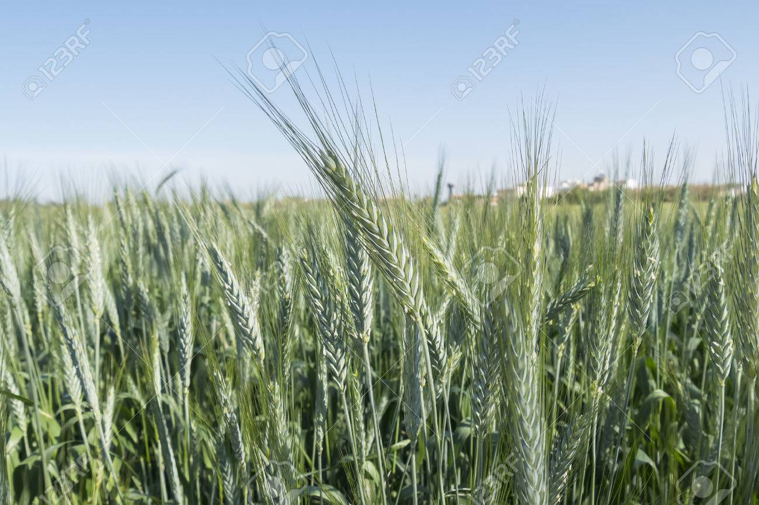
Hola is offered as ``aahuti`` to Agni
The roasted grains were distributed as ``yajna-shesh or prasad

Slide 7
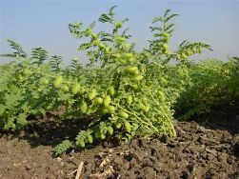
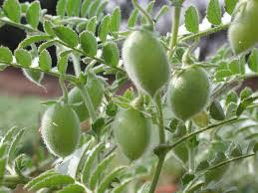

Slide 8
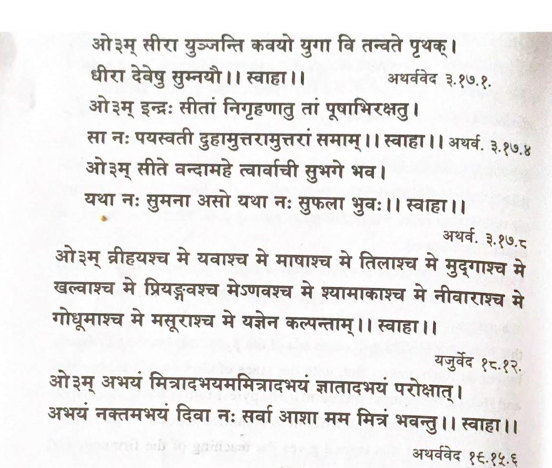
Following ved mantras are recited during holi ahuti

Slide 9
Holi
Celebrated on full moon day of Phalgun month.
Also called Phag or Phagwa
This marks the beginning of New Year, New Harvest, and New Season
After 15 days, Chaitra month, New year, and Basant ritu start
New leaves and flowers bloom
Birds get new feathers

Slide 10
Why do we celebrate Holi?

Slide 11
Why Celebrate
Welcome spring/new season
Celebrate harvest
Welcome New Year
Symbolizes the victory of good or truth over evil or false.
Get rid of material desires and mental impurities
To forgive and not to discriminate based on caste, creed, color, and sex.
Notes:
People believe that they can get rid of their impurities, bad thoughts, bad habits, wrongdoings etc. by giving it to fire and start a new life.
These different colors make people look similar.

Slide 12
How to Celebrate ?

Slide 13
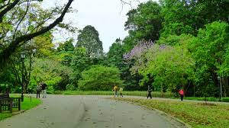
How to Celebrate
Clean home and surroundings
Take shower and wear clean clothes

Slide 14
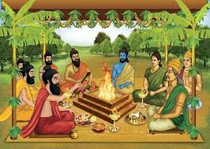
Do yagya यज्ञ

Slide 15
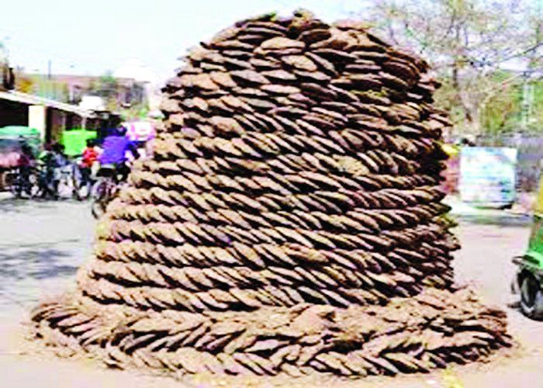
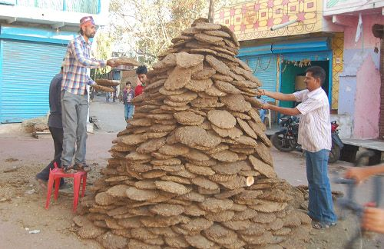
For Holika dahan use cow dung cakes गोबर उपला, not wood for Holika

Slide 16
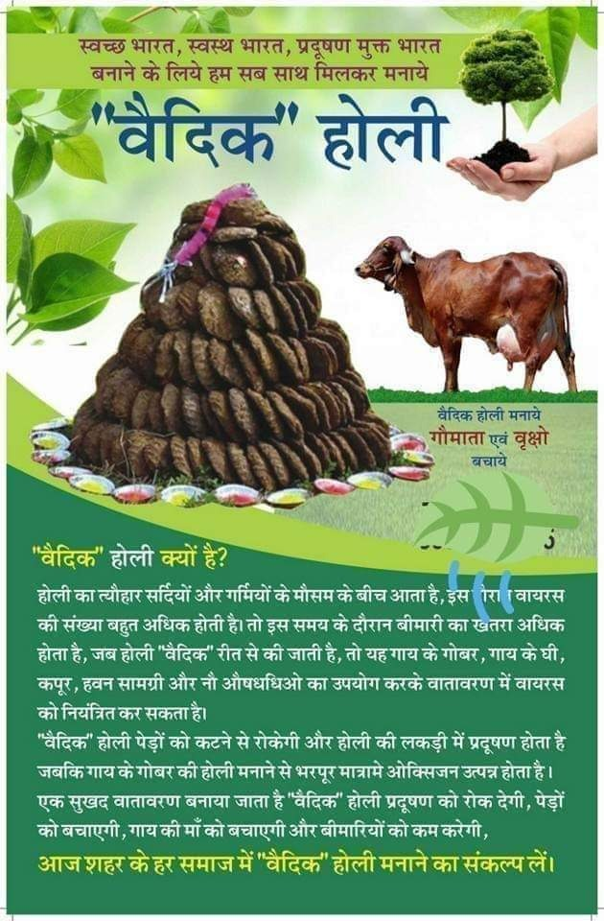

Slide 17
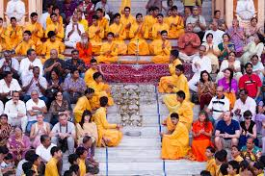
Sing prayers and bhajans

Slide 18
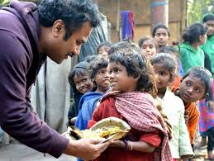
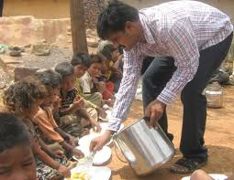
Give abundant charity to poor and needy

Slide 19
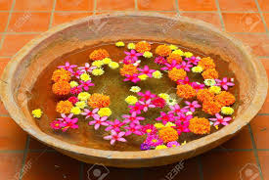
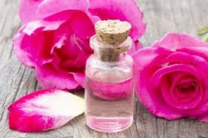
Exchange itr इत्र/Sugandh/Khushboo/Gulab Jaal/ water with flowers immersed in it
These flowers have kaph reducing and detoxifying properties and are good for skin.

Slide 20
Colors-Gulal-Rang
Use organic, natural colors- essences of flowers, vegetables, and herbs.
Purple color from beetroot, Lavender
Yellow color from marigold flower, besan, turmeric/Haldi.
Black color from amla, charcoal
Red from turmeric mixed with Calcium hydroxide or limestone powder, Gulmohar, Flame of the forest or Dhak/Palash, pomegranate, red sandalwood, saffron
Green from coriander, mint, grass, mahendi, neem leaves
White- Raat ki Rani flower
Blue- Indigo

Slide 21
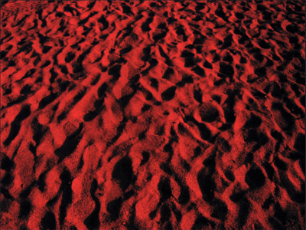
Alta
Red Alta--Organic pigment made from natural oxides in red soil/earth, rakt chandan, and from betel leaves

Slide 22
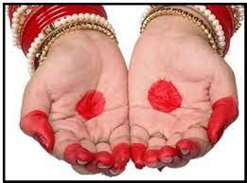
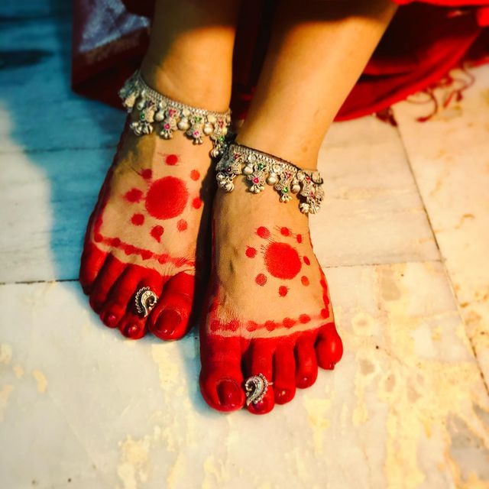
Alta or Mahavar
Cooling benefit
Not harmful to skin
Beautiful bright red color

Slide 23
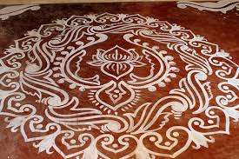
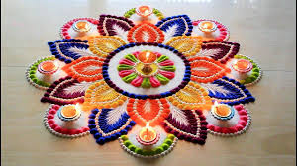
Rangoli or Alpana
Dry rice powder, flower petals, colored sand, etc.
Rice powder mixed with water

Slide 24
Natural colors have a shorter shelf life.
These fade in sunlight within a day.
Natural blue and green are nearly impossible to do vibrantly because they come from expensive spirulina algae, and about 10 times as much material is needed for blending into starch to achieve the brightness.
Some colors require water for processing and if they are not dried quickly, mold can grow.
However, not much water is needed to remove natural colors and there is no harmful effect on skin

Slide 25
Try not to use artificial colors. These can cause irritation of the skin, skin diseases, swelling of eyes, blindness, asthma, kidney diseases, etc.
Some Indian powders may contain toxic, metal-based pigments, such as copper sulfate, mercury sulfide, chromium iodide, lead oxide, and aluminum bromide, or they may be made from potentially hazardous industrial pigments designed for paint or dye applications.
The powder base in some cases is the mineral talc, or possibly even asbestos. Mica granules or ground glass may be added for shine. To make pastes, sometimes the colors are dissolved in used engine oil.
Powder in air looks good but it can enter the lungs leading to health issues.

Slide 26
How not to celebrate
Vikrit Holi

Slide 27
None of these are part of Holi celebrations
Burning wet wood or wood with dust, insects, paint
Burning plastic and leather
Stealing wood from other Holikas
Use of gulal mixed with toxins
Throwing dirty water on face
Tearing clothes
Passing inappropriate remarks
Inappropriate touching
Drinking intoxicants

Slide 28
Vikrit Holi
होली के नाम पर लकड़ी के ढेर जलाना, कीचड़ एवं रंग फेंकना, गुलाल मलना, स्वांग रचना, हुल्लड़ मचाना, शराब पीना, भंग खाना आदि विकृत बातें हैं।
सामूहिक रूप से नवसंस्येष्टि अर्थात् नई फसल के अन्न से वृहद् यज्ञ करना पूर्णतया वैज्ञानिक था। इसी बात का विकृत रूप लकड़ी के ढेर जलाना है।
गुलाब जल अथवा इत्र का आदान-प्रदान करना मधुर सामाजिकता का परिचायक था। इसी का विकृत रूप गुलाल मलना है।
ऋतु परिवर्तन पर रोगों एवं मौसमी बुखार से बचने के लिए टेसू के फूलों का जल छिड़कना औषधि रूप था। इसी का विकृत रूप रंग फेंकना है।
प्रसन्न होकर आलिंगन करना एवं संगीत-सम्मेलन करना प्रेम तथा मनोरंजन के लिए था। इसी का विकृत रूप हुल्लड़ करना और स्वांग भरना है।
कीचड़ फेंकना, वस्त्र फाड़ना, मद्य एवं भंग का सेवन करना आदि तो असभ्यता के स्पष्ट लक्षण हैं।

Slide 29
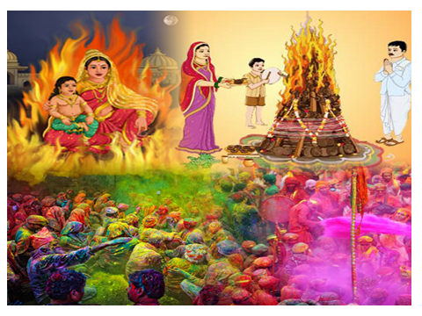
Questions
and
Answers

Slide 30
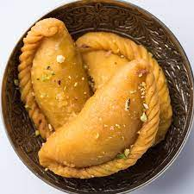
Famous sweet मिठाई of Holi?
Gujiya

Slide 31
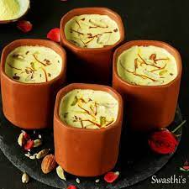
Famous drink of Holi?
Thandai

Slide 32
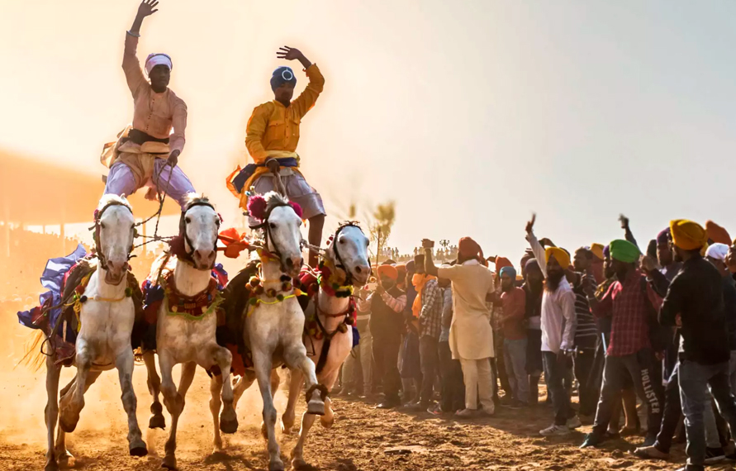
Who started Hola Mohalla?
Guru Gobind Singh
It is a three day event and there is a display of mock wars at Anandpur Sahib

Slide 33
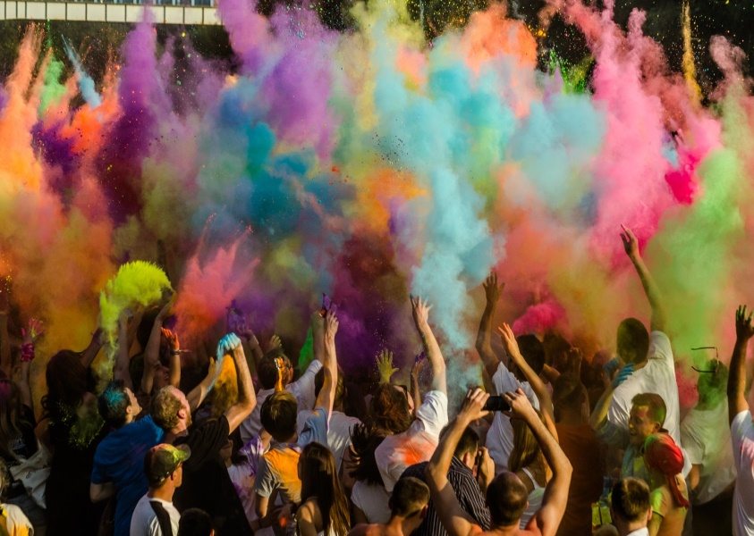
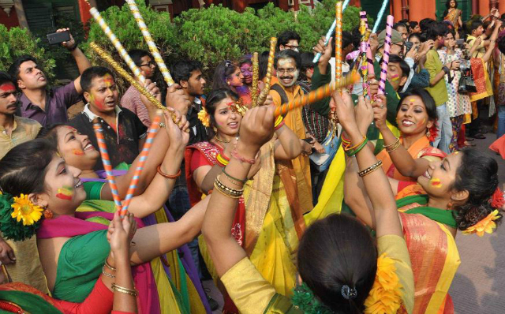
Which states celebrate Holi as Dol Yatra ?
Odhisa, Assam, West Bengal
Also known as Dol Purnima
Celebrated by Krishna followers

Slide 34
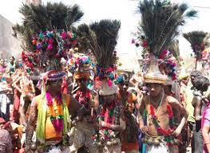
Where and when do people celebrate Kavant Mela ?
Gujarat, North East region
Third day after Holi
Tribal festival
Rathva adivasis are considered to be one of the largest tribes in the state of Gujarat and have a hunter’s background

Slide 35
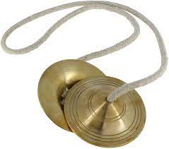
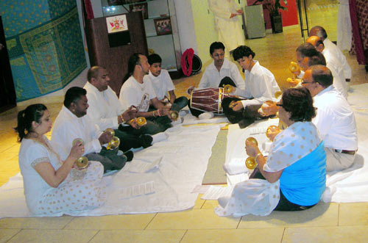
What is the name of Caribbean Holi Lok Geet?
Chowtal
Folk song of North India’s Bhojpuri region
Name of a Taal in Indian Classical Music
Dholak and Manjeera

Slide 36
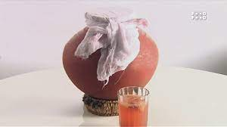
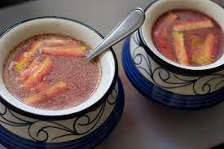
Kanji
What is this?

Slide 37
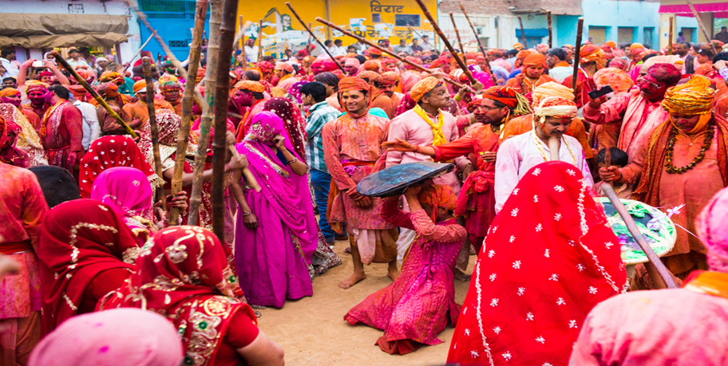
Where do people celebrate Lathmar लठमार Holi?
Barsana- Radha Rani Mandir
Huranga holi
Dauji Temple
Ladoo mar Holi

Slide 38
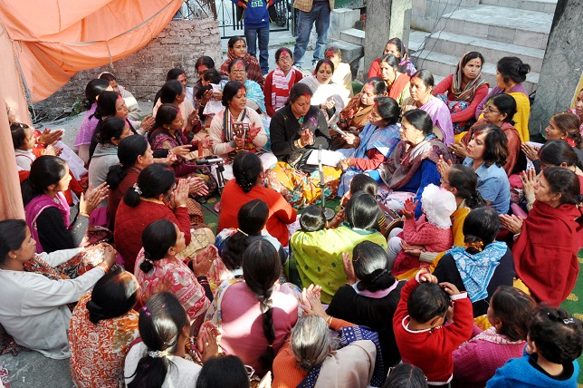
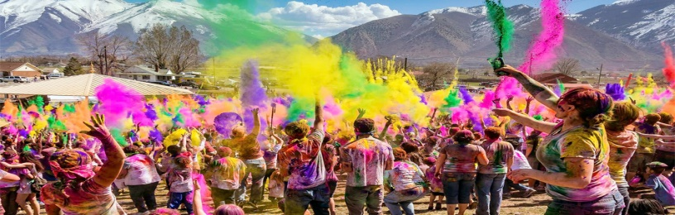
Is there a Khadhi खड़ी and Baithi बैठी Holi?
Yes, in Kumaon, Uttrakhand

Slide 39
Baithi, Nagaar or Urban Holi
People sit together, play musical instruments, sing songs, eat food and sweets.
Khadi, Rural, Thaad Holi
Tie a cloth around a tree, sing, and dance
Mahila Holi

Slide 40
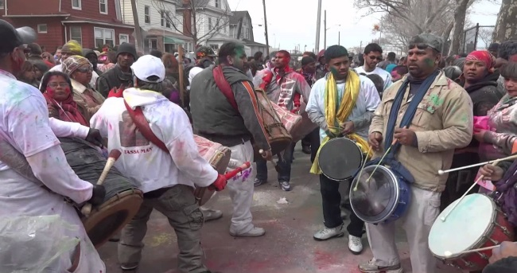
The Annual Phagwa parade happens in which US state?
New York
Holi is celebrated as Phagwa festival in Surinam, Gyana, Trinidad, Tobago, Jamaica

Slide 41
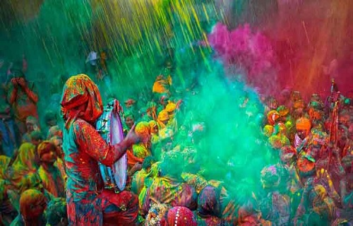
Rang Panchmi comes______ days after Holi
Five
Celebrated in Madya Pradesh and Maharastra

Slide 42
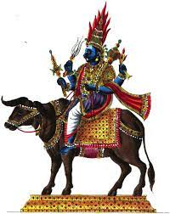
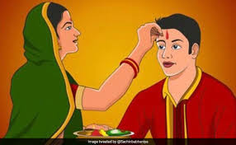
In which Indian state people celebrate Bhai Dooj after Holi ?
Madya Pradesh
Prayers to Yam
Beat wild plant in cowdung(enemy of brothers)

Slide 43
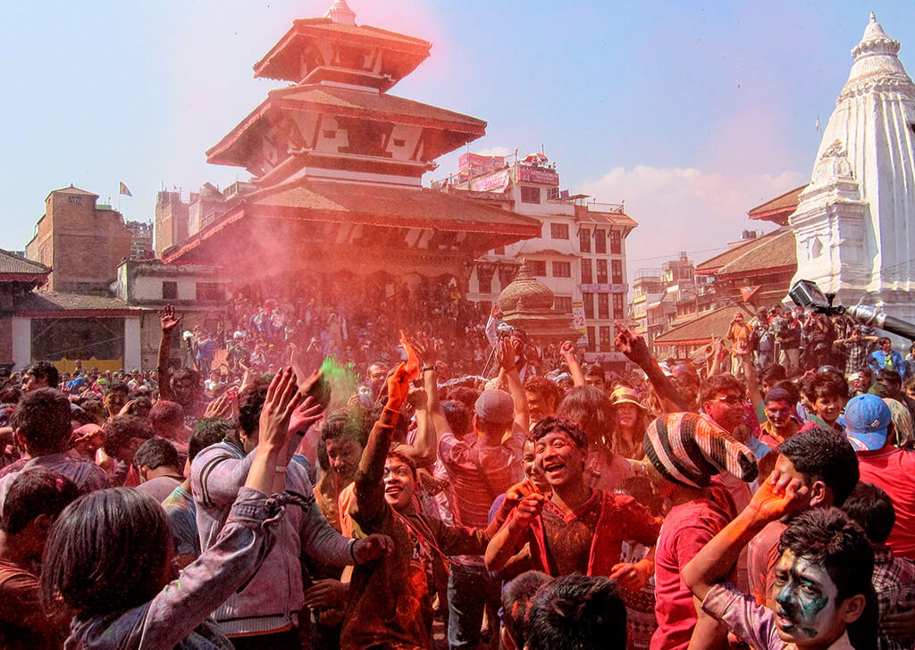
Holi is national holiday in which countries?
India and Nepal
Fagu Purnima

Slide 44
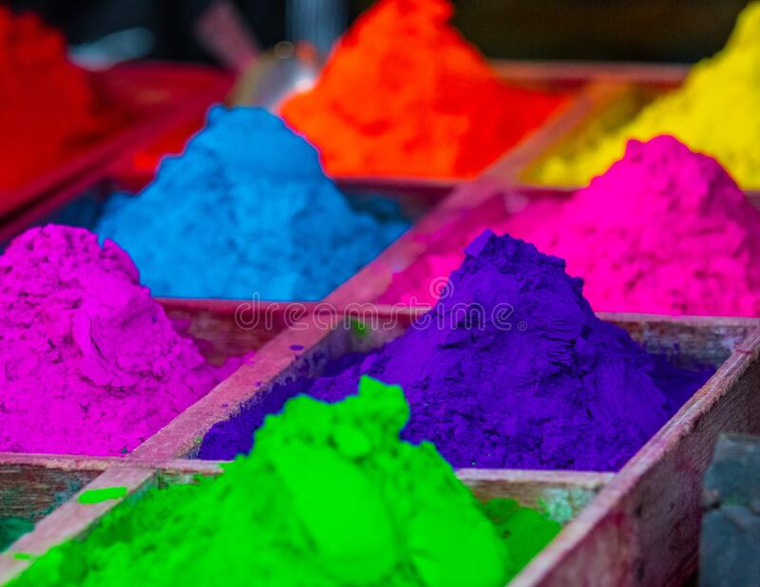
What is the other name of Gulal?
Abir, Abeer, Abhir, Rang

Slide 45
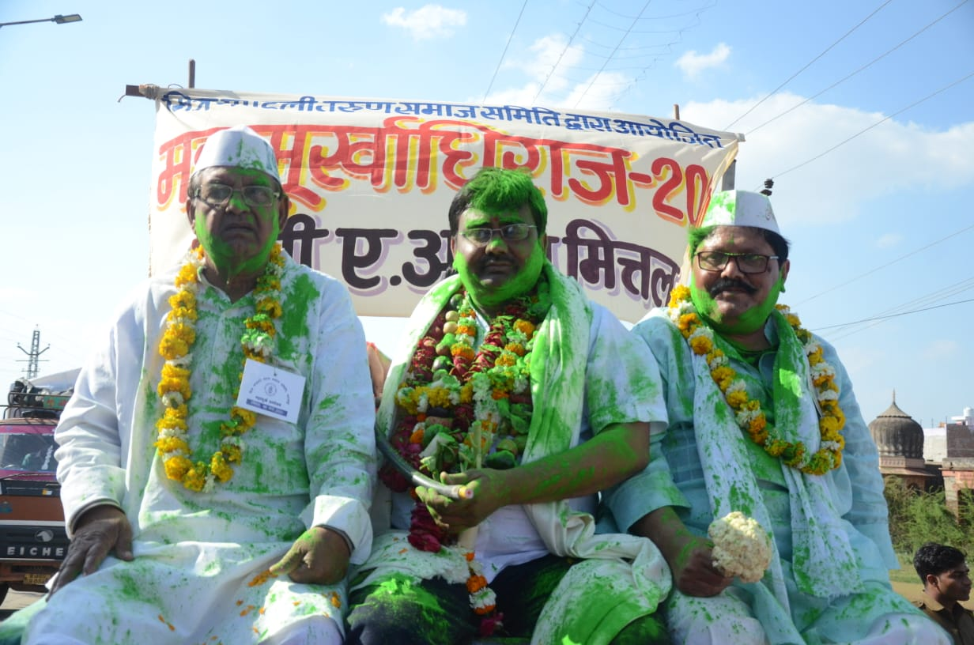
What type of Kavi Sameelans are organized around Holi ?
Mahamurkh kavi Sameelan

Slide 46
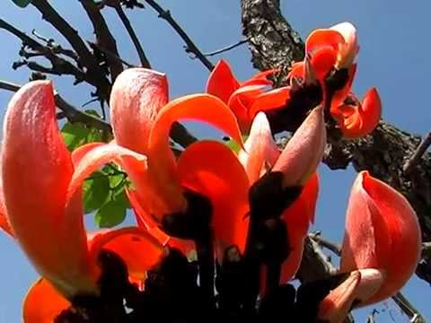
Important Holi Flower
Palash/Tesu/Dhak
State flower of Jharkhand/Chattisgarh

Slide 47
Other names of Holi Festival
Shigmo spring festival- Goa
Yaosang- Manipur
Manjal Kuli—Kerala
Phaguwa- Bihar
Phakuwah- Aasam

Slide 48
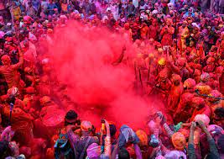
Thank You

