Slide 1
Prominent Kings
Satavahanas are oldest known kings of Telugu origin from 4 BCE to 1 CE. The Satavahana empire consisted of a large part of south India and extended all the way to current deep west to current day Rajasthan. The greatest of the Satavahanas is Gautamiputra Satakarni, in whose reign, the empire expanded very wide. One of the two most used Bharatiya calendars is on his name as Shalivahana Shaka. The other is Vikram Samvat. Until the time of Gautamiputra, Telugu language was using Devanagari and Brahmi scripts. He initiated a script for the language and the first word written in the language is “Nagabu”. This inscription can be found in Nagarjuna museum near Nagarjuna Sagar dam.
After Satavahanas, Ikshvaku dynasty is known to have ruled the region for a good long time.
Kakatiyas were another dynasty that ruled the region with great valor. Rani Rudramadevi is the most known queen of the dynasty. This dynasty resisted the muslim incursion into the region for a long time. Golconda fort, a prominent landmark of Bhagyanagar is built in their time period.
The region had its golden period after Satavahanas, during the reign of Vijayanagar empire. Specially under the rule of the greatest emperor, the mighty Sri Krishna Devaraya. Though cannot be owned absolutely by telugus, Sri Krishna Devaraya happens to be the undisputed great emperor of telugus. His valor made entire southern India a part of kingdom. The literary works in telugu, arts and architecture reached its zenith during his time. His literary work “Amukta Malyada” in telugu is one of the best. He constructed many temples and the current structure of temple at Tirumala is constructed by him. Tenali Ramakrishna belonged to his court.
After the fall of Vijayanagar empire, There were smaller known kings like Gajapatis in the east, Musunuris in the central east, Reddy kings in the south, ruled parts of the region before it fell to Bahmanis and then to Mughals and finally to British.

Slide 2
Telugu Freedom Fighters
Alluri Seetarama raju – Vanavaasi freedom fighter and revolutionary. A legendary freedom fighter on the lines of Netaji, whose chose to bear arms to rebel against the British. Was very successful in hit and run incidents causing significant damage to british establishments in north Andhra.
Komaram Bheem – A great tribal leader who was instrumental in fighting the combination of British & Nizam regimes. The current RRR movie is based on above 2 legends.
Uyyalawada Narasimha Reddy – one of the first to rebel against the british in Madras Presidency. His rebellion in 1847 is considered to be first mutiny before the 1857 revolution.
Tanguturi Prakasam Pantulu– Titled Andhra Kesari, he was phenomenal in inspiring people with his speeches during freedom struggle. He was also the Chief Minister of combined Madras state after independence before state re-organization. He was the first chief minister of re-organized Andhra Pradesh.
Pingali Venkayya – A well known freedom fighter who designed the national flag.
Pattabhi Seetaramayya - He ran for the presidency of the Indian National Congress as the candidate closest to Gandhi against Netaji in Tripuri session of 1939. He later founded Andhra bank, a prominent national bank which is now merged into Union Bank.
Potti Sriramulu – Instrumental for forming the Andhra state. He undertook a 58 day hunger strike asking for a separate state and died on the 58th day after which Nehru and Patel consented.
Swami Ramananda Teertha – Arya Samaj was instrumental among many organizations that fought for liberation of Hyderabad, a second freedom struggle after independence. Swamiji was in forefront in inspiring people to fight for freedom and stopping conversions.

Slide 3
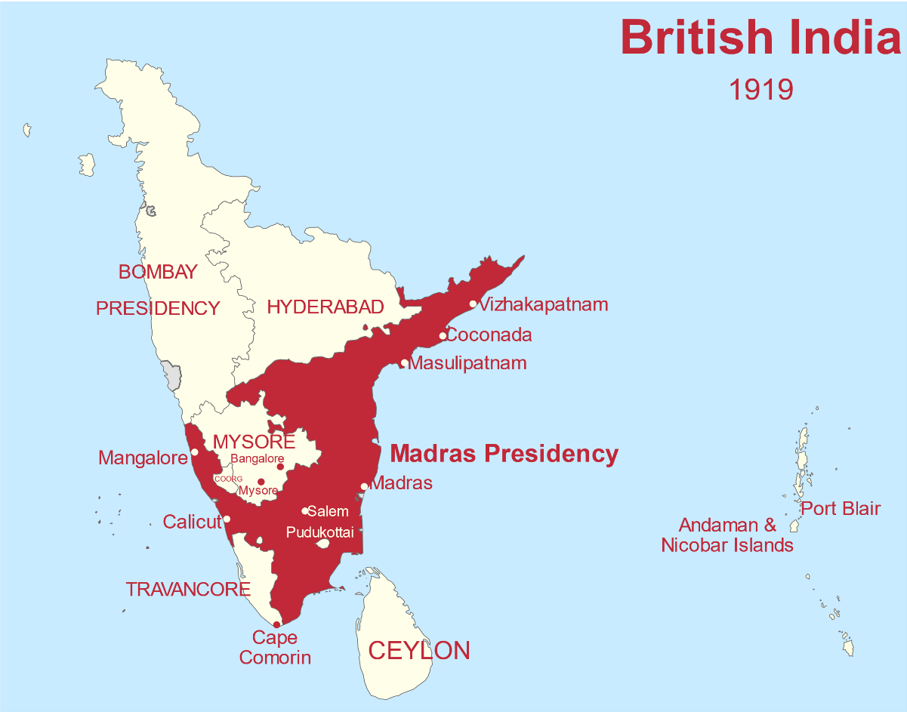
Formation of Linguistic states and Andhra Pradesh
By the time Bharat attained independence in 1947 entire south India was 3 princely states and one Presidency. The princely states were, Hyderabad, Mysore and Travancore, while the presidency was Madras Presidency later changed to Madras state after independence.
The state of Madras was huge covering a lot of area and people speaking multiple languages.
Discrimination and unrest added to the inability of the central government to effectively curb the discrimination led to linguistic re-organization of states.
Andhra was the first state to be formed on a linguistic basis on 1 October 1953.
Later the rest of the linguistic areas were separated and new states were formed in November 1956. The Telugu speaking areas from Hyderabad state were merged into Andhra and a new state Andhra Pradesh was formed on November 1, 1956. Similarly, Marathi speaking areas went to Maharashtra and Kannada speaking areas to Karnataka.
In 2004, the state of Andhra Pradesh was split into two Telugu speaking states of Andhra Pradesh and Telangana.

Slide 4
Most popular Pilgrimage Centers
Tirupati & Tirumala – Lord Venkateswara (Balaji) on the 7 hills and Goddess Padmavati’s temple below the hills.
Bhadrachalam – Sri Ram temple.
Srirsailam – Mallikarjuna Swamy, this is one of the 12 Jyotirlinga centers.
Brahmarambika Devi - this is one of the 18 Maha Shakti peeth and Sati Devi’s neck fell here. Kills demon Arunasura as a 6 legged bee.
Pithapuram – Puruhutika Devi, also one of the 18 Maha Shakti peeth. Sati devi’s left hand fell here. Sripada Srivallabha saint was born here in 14th century, considered incarnation of Lord Dattatreya.
Alampur - Jogulamba Devi, this is one of the 18 Maha Shakti peeth and is now in Telangana. Sati devi’s upper teeth fell here. Grounded by Bahamanis and now rebuilt.
Annavaram – Satyanarayana swamy
Simhachalam- Narasimha swamy
Arasavilli – Surya bhagwan, one of the few temples dedicated to the Sun God.
Srikurmam – Kurma avatar, the only temple in Bharat dedicated to the Kurma avatar of Vishnu.
Bhadrachalam – A temple dedicated to Lord Rama on the banks of Godavari.

Slide 5
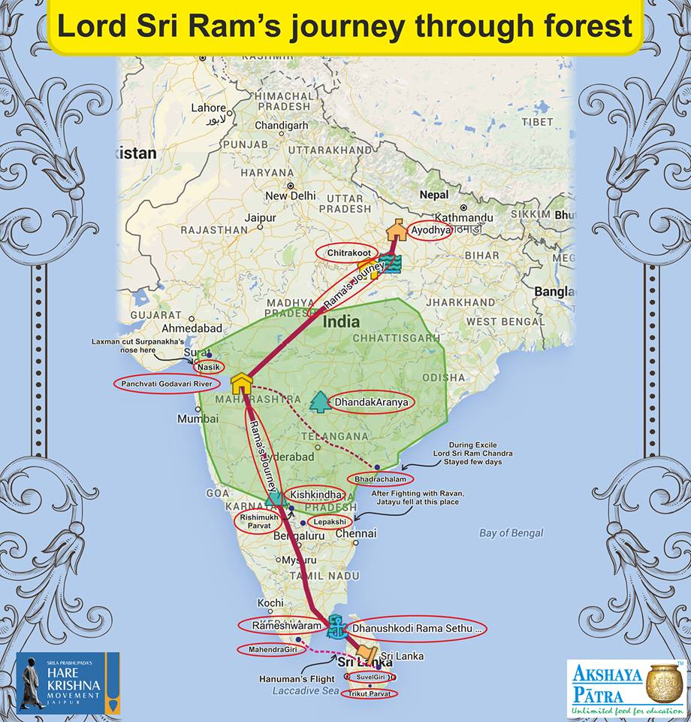

Slide 6
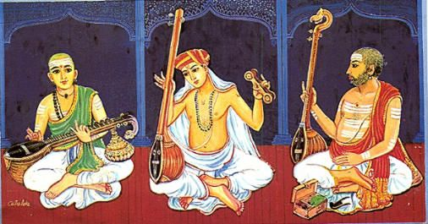
Carnatic Music
The Trinity of Carnatic music are
Thyagaraja Swamy (1767–1847)
Mutthuswamy Dikshitar (1775–1835)
Shyama Sastry (1762–1827)
Tallapaaka Annamacharya (1408 – 1503) A 15th century saint who is the earliest known Hindu musician to compose songs called Sankeertanas on Lord Venkateswara. He composed 32,000 sankeertanas of which only 12,000 exist today.
Kancharla Gopanna aka Bhakta Ramadasu (1620 – 1688) A 16th century saint-poet who composed classical music on Lord Rama. He built the temple of Bhadrachalam.

Slide 7
Telugu Cinema/Tollywood
Initially the Telugu film industry was located in Chennai in Tamilnadu. Then in 1990s, the stalwarts of the Telugu industry decided that they will move the Telugu film production from TN to Andhra Pradesh. So in early 1990s the industry moved to Hyderabad and just after a short 30+ years, today it is the largest film Industry in South Asia in terms of box office.
Actors
N.T. Rama Rao
Savitri – First female superstar of South India.
Sridevi – Half telugu, started as a child actor in telugu movies.
Jayaprada
Waheeda Rehman – Her debut film was in Telugu
https://www.youtube.com/watch?v=VH72kvy0y98
Hema malini – Her debut film was in Telugu, Paandava vanavaasam
Rekha – Half telugu
https://www.youtube.com/watch?v=X9MiXKjRMYM
Playback singers
P Suseela – Over 50,000 songs across all South Indian languages
S Janaki - Over 50,000 songs across all South Indian languages
S P Balasubrahmanyam - Over 40,000 songs across many languages.

Slide 8
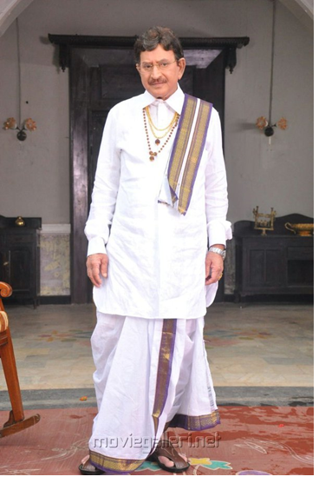
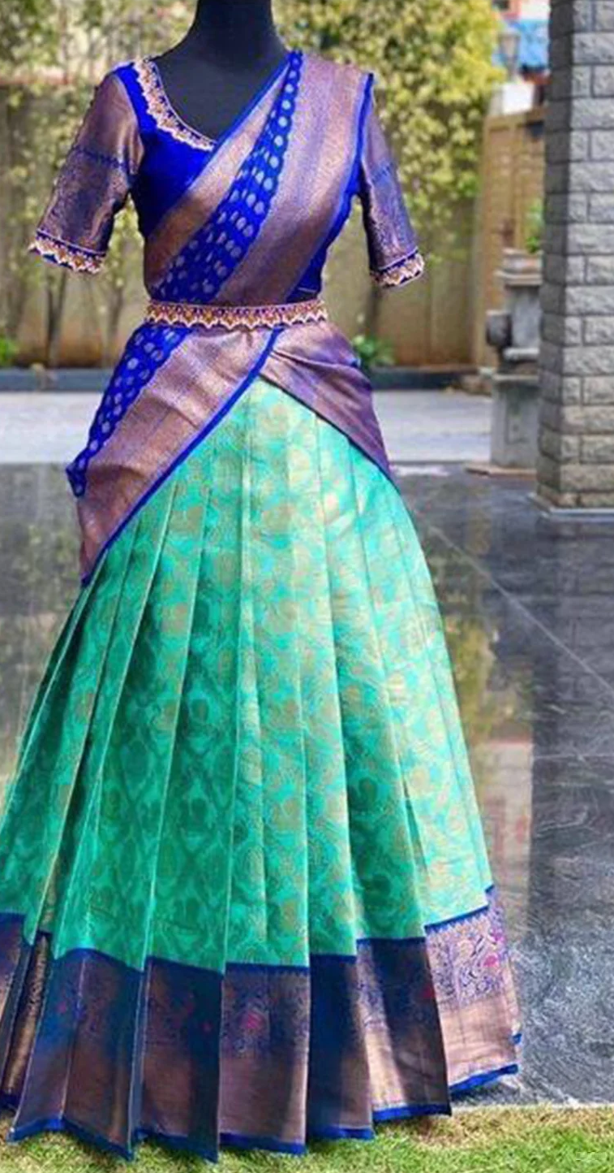
Attire and Sarees from Andhra Pradesh
Langa/Parikini & Voni
Cheera (Saree)
Panche (Dhoti)
Lungi
Sarees –
a. Gadwal
b. Pochampally
c. Mangalagiri
d. Uppada
e. Dharmavaram
f. Guntur zari
g. Venkatagiri zari

Slide 9
